Slide 1
Functions in C

Slide 2
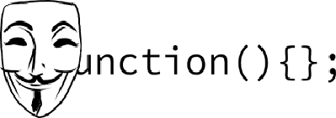
Functions in C
Notes:
This presentation demonstrates the new capabilities of PowerPoint and it is best viewed in Slide Show. These slides are designed to give you great ideas for the presentations you’ll create in PowerPoint 2010!
For more sample templates, click the File tab, and then on the New tab, click Sample Templates.

Slide 3
1. Through this lecture, students will understand
the need of functions, how to declare and
define functions in C.
2. Students will learn the two methods of function
calling – call by value and call by reference.
3. Students will be acquainted with the concept of recursion, their declaration and definition.
Learning
Outcomes

Slide 4
Contents
What is Function?
Need of Function
Types of function
Function declaration and definition
Call by value and call by reference
Recursion

Slide 5
Functions
Also called subroutine in some other languages like php, python
Self contained block of code that performs a specific task
A function is named
It is independent which can perform its task without interference from or interfering with other parts of the program.
Every C program has at least one function, which is main()
A function is defined using its predefined syntax, and are called from elsewhere in your program.

Slide 6
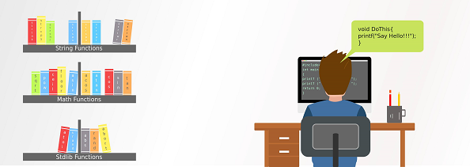

Slide 7
Why Functions?
Improves the readability of code
Debugging of code is easier, errors are easy to be traced.
Reduces the size of the code
Improve Modularity
Avoid duplicating codes

Slide 8
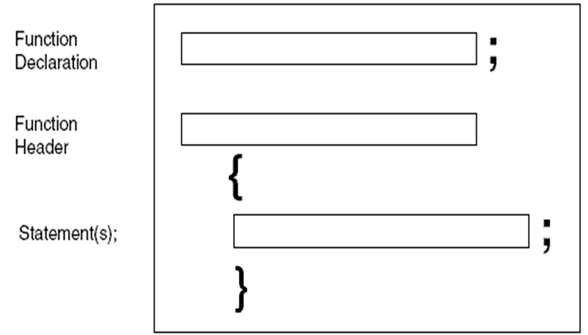
C Functions: Most basic Form

Slide 9
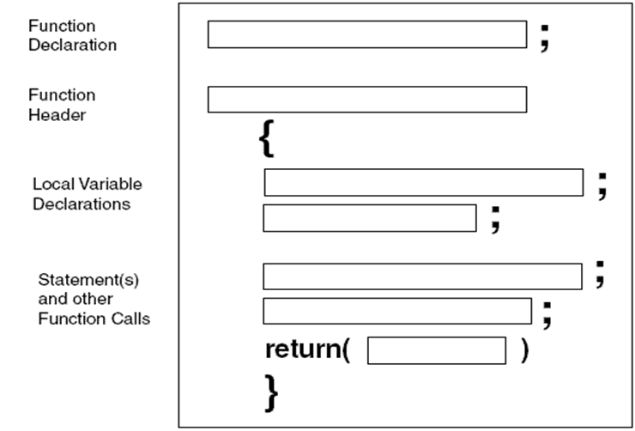
C Functions: General Form

Slide 10
Types of functions
Library Functions
Built-in functions to handle tasks such as mathematical computations, I/O processing, string handling etc.
Defined in the header file
printf() : function to send formatted output to the screen : defined in "stdio.h" header file.
4. Some other library functions are scanf() to read input from the screen, getchar() to return characters typed on screen, putchar() to output a single character to the screen, fopen() to open a file, fclose() to close a file etc.
User-defined Functions
Users or programmers define a function according to their requirement.
The main() function is also a user-defined function because the statements inside the main function is defined by the user, only the function name is defined in a library.

Slide 11
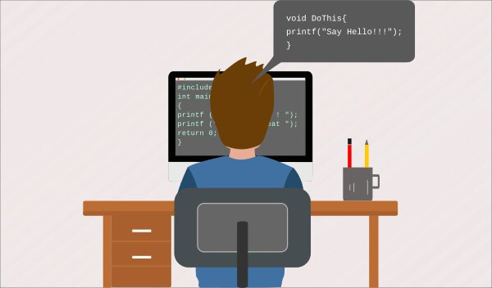
User Defined Functions
”What you have to do when I call you“
A programmer can define their own sets of code inside a function and use it for n number of times using its function name.

Slide 12
Function Declaration
A declaration merely provides a function prototype.
It tells the compiler about a function's name, return type, and parameters.
Function header :
Includes the return type and the list of parameters
Syntax:
return_type function_name( arg-typ name-1,...,arg-typ name-n);
Example:
int hex(int val);
int max(int num1, int num2);
Note: 1. Parameter names are not important in function declaration only their type is required, so int max(int, int); is also a valid declaration
2. Function declaration is required when you define a function in one source file and you call that function in another file.

Slide 13
Function Definition
The definition of a function includes both the function prototype and the function body, i.e. its implementation.
Syntax : return_type function_name (argument list)
{
Set of statements – Block of code
}
return_type
Can be of any data type such as int, double, char, void, short etc.
function_name
Easy to understand the purpose of function seeing it’s name
argument list
Contains variables names along with their data types
Kind of inputs for the function
Block of code
Set of C statements, which will be executed whenever a call will be made to the function.
Advised to have a meaningful name

Slide 14
Calling a function
By creating a C function, we give a definition of what the function has to do.
To use a function, we will have to call that function to perform the defined task.
When a program calls a function, the program control is transferred to the called function which performs a defined task
When its return statement is executed or when its closing brace is reached, it returns the program control back to the main program.
To call a function, you simply need to pass the required parameters along with the function name.
If the function returns a value, then we can store the returned value.

Slide 15
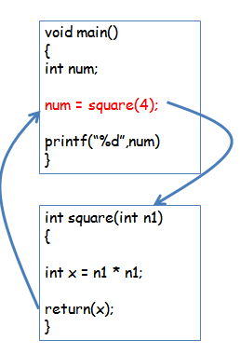
Illustration of working of Functions in C

Slide 16
Example of functions
#include <stdio.h>
int main()
{ //main function definition
int a = 5, b = 10;
int sum;
printf("The value of a and b : %d %d ", a, b);
sum = add(a, b); //function call
printf("\nsum = %d ", sum);
}
//function definition
int add(int a, int b)
{
int c;
c = a + b;
return c; //returns a integer value to the calling function
}
The value of a and b : 5 10
sum = 15

Slide 17
Classification of user defined functions into four types, according to parameters and return value
Functions without arguments but with return values
Functions without arguments and without return values
Functions with arguments but without return values
Functions with arguments and with return values

Slide 18
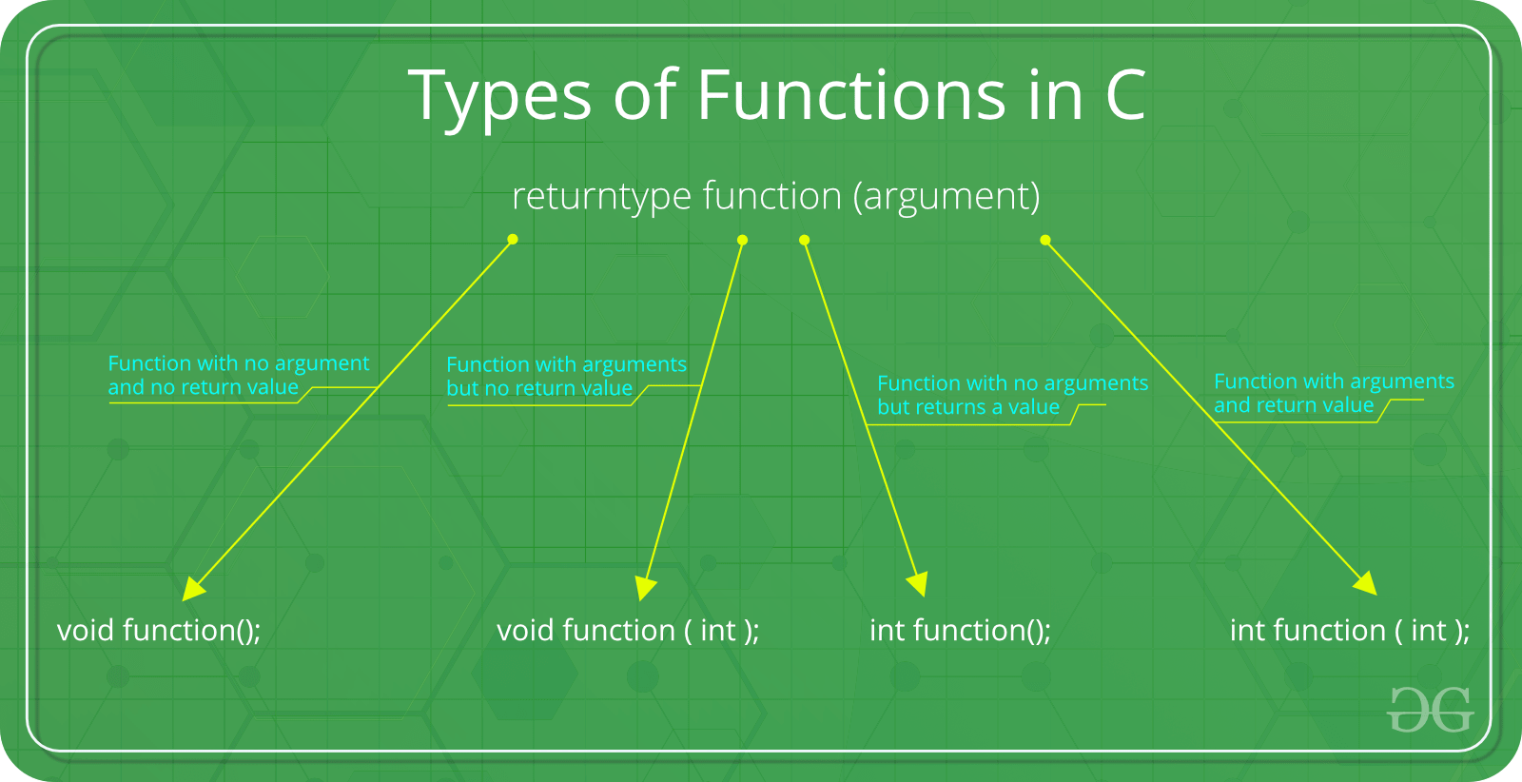

Slide 19
Functions Without Arguments Without Return Values
The calling function will not send parameters to the called function and called function will not pass the return value to the calling function.
#include <stdio.h>
void add(); //function declaration
int main()
{ //main function definition
add(); //function call without passing arguments
}
//function definition
void add()
{ int a = 5, b = 10;
int c;
printf(" The values of a and b : %d %d ", a, b);
c = a + b;
printf(" \nsum : %d ", c); //no return values to the calling function
}
The value of a and b : 5 10
sum = 15

Slide 20
Functions With Arguments Without Return Values
The calling function will pass parameters to the called function but called function will not pass the return value to the calling function.
#include <stdio.h>
void add(int,int); //function declaration
int main()
{ //main function definition
int sum;
int a = 5, b = 10;
printf(" The values of a and b : %d %d ", a, b);
add(a, b); //function call with passing arguments to called function }
// function definition
void add(int a, int b)
{
int c;
c = a + b;
printf(" \nsum : %d ", c); //no return values to the calling function main
}
The value of a and b : 5 10
sum = 15

Slide 21
Functions Without Arguments With Return Values
The calling function will not pass parameters to the called function but called function will pass the return value to the calling function.
#include <stdio.h>
int add(); //function declaration
int main()
{ //main function definition
int sum;
sum = add(); //function call without passing arguments to called function
printf(" \nsum = %d ", sum);
}
// function definition
int add()
{ int c;
int a = 5, b = 10;
printf(" The values of a and b : %d %d ", a, b);
c = a + b;
return c; //passing return values to the calling function main }
The value of a and b : 5 10
sum = 15

Slide 22
Functions With Arguments With Return Values
The calling function will pass parameters to the called function and called function also pass the return value to the calling function
#include <stdio.h>
int add(int, int); //function declaration
int main()
{ //main function definition
int sum;
int a = 5, b = 10;
printf(" The values of a and b : %d %d ", a, b);
sum = add( a, b); //function call with passing arguments
printf(" \nsum = %d ", sum);
}
// function definition
int add(int a, int b)
{ int c;
c = a + b;
return c; //passing return values to the calling function main
}
The value of a and b : 5 10
sum = 15

Slide 23
Function Parameters
There are two types of function parameters:
Formal parameters:
Appear in a declaration or a definition of a function.
Actual parameters:
Appear in a call to the function.
Examples:
int f(int x); here x is a formal parameter
i = f(3); here 3 is the actual parameter corresponding to the formal parameter.

Slide 24
Demonstrating difference between actual and formal arguments
#include <stdio.h>
int addTwoInts(int, int); /* Prototype */
int main() /* Main function */
{
int n1 = 10, n2 = 20, sum;
/* n1 and n2 are actual arguments. They are the source of data. Caller program supplies the data to called function in form of actual arguments. */
sum = addTwoInts(n1, n2); /* function call */
printf("Sum of %d and %d is: %d \n", n1, n2, sum);
}
int addTwoInts(int a, int b)
/* a and b are formal parameters. They receive the values from actual arguments when this function is called. */
{ return (a + b); }
OUTPUT ====== Sum of 10 and 20 is: 30

Slide 25
Difference between Actual and Formal Parameters
Actual vs Formal Parameters
The Actual parameters are the values that are passed to the function when it is invoked. | The Formal Parameters are the variables defined by the function that receives values when the function is called.
Related Function
The actual parameters are passed by the calling function. | The formal parameters are in the called function.
Data Types
In actual parameters, there is no mentioning of data types. Only the value is mentioned. | In formal parameters, the data types of the receiving values should be included.

Slide 26
Call by value and Call by reference

Slide 27
Two ways of passing arguments to a function
Call by Value | Call by Reference
While calling a function, we pass values of variables to it. Such functions are known as “Call By Values”. | While calling a function, instead of passing the values of variables, we pass address of variables(location of variables) to the function known as “Call By References”.
2. In this method, the value of each variable in calling function is copied into corresponding dummy variables of the called function. | 2. In this method, the address of actual variables in the calling function are copied into the dummy variables of the called function.
3. With this method, the changes made to the dummy variables in the called function have no effect on the values of actual variables in the calling function. | 3. With this method, using addresses we would have an access to the actual variables and hence we would be able to manipulate them

Slide 28
// C program to illustrate call by value
#include <stdio.h>
// Function Prototype
void swapx(int x, int y);
// Main function
int main()
{ int a = 10, b = 20;
// Pass by Values
swapx(a, b);
printf("a=%d b=%d\n", a, b);
return 0; }
// Swap functions that swaps two values
void swapx(int x, int y)
{ int t;
t = x;
x = y;
y = t;
printf("x=%d y=%d\n", x, y); }
Output: x=20 y=10 a=10 b=20

Slide 29
// C program to illustrate call by reference
#include <stdio.h>
// Function Prototype
void swapx(int x, int y);
// Main function
int main()
{ int a = 10, b = 20;
// Pass by Reference
swapx(&a, &b);
printf("a=%d b=%d\n", a, b);
return 0; }
// Swap functions that swaps two values
void swapx(int* x, int* y)
{ int t;
t = *x;
*x = *y;
*y = t;
printf("x=%d y=%d\n", *x, *y); }
Output: x=20 y=10 a=20 b=10

Slide 30
Call by Value | Call by Reference
4. Thus actual values of a and b remain unchanged even after exchanging the values of x and y. | 4. Thus actual values of a and b get changed after exchanging values of x and y.
5. In call by values we cannot alter the values of actual variables through function calls. | 5. In call by reference we can alter the values of variables through function calls.
6. Values of variables are passed by Simple technique. | 6. Pointer variables are necessary to define to store the address values of variables.
7. A copy of the original variables are created in memory stack. | 7. No copy of the variables are created on the memory stack.
8. The pass by value approach creates two or more copies of the original variables and, hence it is not memory efficient. | 8. The pass by reference method creates only a single copy, thereby, providing memory efficiency.
9. The changes are visible only in a particular method where the arguments are passed. | 9. The changes are visible in every function.

Slide 31
Program to check prime numbers between two integers
#include <stdio.h>
int checkPrimeNumber(int n);
int main()
{ int n1, n2, i, flag;
printf("Enter two positive integers: ");
scanf("%d %d", &n1, &n2);
printf("Prime numbers between %d and %d are: ", n1, n2);
for(i=n1+1; i<n2; ++i) {
// i is a prime number, flag will be equal to 1
flag = checkPrimeNumber(i);
if(flag == 1) printf("%d ",i); }
return 0; }
// user-defined function to check prime number
int checkPrimeNumber(int n)
{ int j, flag = 1;
for(j=2; j <= n/2; ++j)
{ if (n%j == 0) { flag =0; break; } }
return flag; }
Enter two positive integers: 12 30
Prime numbers between 12 and 30 are: 13 17 19 23 29

Slide 32
Program to Check Whether a Number can be Expressed as Sum of Two Prime Numbers
#include <stdio.h>
int checkPrime(int n);
int main()
{ int n, i, flag = 0;
printf("Enter a positive integer: ");
scanf("%d", &n);
for(i = 2; i <= n/2; ++i)
{ // condition for i to be a prime number
if (checkPrime(i) == 1)
{ // condition for n-i to be a prime number
if (checkPrime(n-i) == 1)
{ // n = primeNumber1 + primeNumber2
printf("%d = %d + %d\n", n, i, n - i); flag = 1; } } }
if (flag == 0)
printf("%d cannot be expressed as the sum of two prime numbers.", n);
return 0; }
// Function to check prime number
int checkPrime(int n) { int i, isPrime = 1; for(i = 2; i <= n/2; ++i) { if(n % i == 0) { isPrime = 0; break; } } return isPrime; }
Enter a positive integer: 34
34 = 3 + 31
34 = 5 + 29
34 = 11 + 23 34 = 17 + 17

Slide 33
Program to check prime and armstrong number using function
Program to print maximum of three numbers using function.
Program to find square of a given number using function
Write a program in C to check a given number is even or odd using the function
Implement C programs

Slide 34
Quiz

Slide 35
What will be the output of the C program?
In C, parameters are always
Passed by value B. Passed by reference
C. Non-pointer variables are passed by value and pointers are passed by reference
D. Passed by value result
2. #include<stdio.h>
int main()
{ function(); return 0; }
void function()
{ printf("Function in C is awesome"); }
A. Function in C is awesome B. no output C. Runtime error D. Compilation error
3. #include<stdio.h>
int main()
{ main(); return 0; }
A. Runtime error B. Compilation error C. 0 D. none of the above

Slide 36
4. #include<stdio.h>
int function();
main()
{ int i;
i = function();
printf("%d", i);
return 0;
}
function()
{ int a;
a = 250;
return 0;
}
A. Runtime error B. 0 C. 250 D. No output

Slide 37
5. #include<stdio.h>
int function();
main()
{ int i;
i = function();
printf("%d", i);
return 0; }
function()
{ int a; a = 250; }
A. 250 B. 0 C. 1 D. Some Garbage value
6. #include<stdio.h>
int function(int, int);
int main()
{ int a = 25, b = 24 + 1, c;
printf("%d", function(a, b));
return 0; }
int function(int x, int y) { return (x - (x == y)); }
A. Compilation error B. 25 C. 1 D. 24

Slide 38
7. What will be the output of the C program by considering 'c' as a User input?
#include<stdio.h>
int main()
{ char c = ' ', x;
getc(c);
if((c >= 'a') && (c <= 'z'))
x = convert(c);
printf("%c", x); return 0; }
A. Runtime Error B. Any symbols or special characters C. Compilation Error D. B
8. #include<stdio.h>
int main()
{ int num = returns(sizeof(float));
printf("Value is %d", ++num); return 0; }
int returns(int returns)
{ returns += 5.01;
return(returns); }
A. 9 B. Compilation error C. 10 D. None of the above

